Slide 1
Agenda
Memory Exposure Reduction
Process level (ASPLOS 2020)
Intra-process level (ISCA 2020)
Programming support (HPCA 2022)
Persistent Memory Defragmentation (ISCA 2022)
SoftPM: Software Persistent Memory (In submission)
SoC Contention Modeling (MICRO 2021)

Slide 3
Memory Expousure Reduction Background
Memory attack
Prevent out-of-bound access
Dangling Pointer
Victim Data/Code
Reduced performance for normal execution
Memory
Limited programmability

Slide 4
Memory Expousure Reduction Background
Trusted/Untrusted regions are identifiable
Solution: Permission control
Code A (trusted)
Data A
Disable Data A and Data C permission
Code B (untrusted)
Data B
Enable Data A and Data C permission
Code C (trusted)
Data C

Slide 5
Memory Expousure Reduction Background
Trusted/Untrusted regions are unidentifiable
Solution: Principle of least privilege, reduce memory exposure
Disable all data permission
Enable Data A permission
Code A
Data A
Disable Data A permission
Enable Data B permission
Code B
Data B
Disable Data B permission
Enable Data C permission
Code C
Data C
Disable Data C permission

Slide 6
Agenda
Memory Exposure Reduction
Process level (ASPLOS 2020)
Intra-process level (ISCA 2020)
Programming support (HPCA 2022)
Persistent Memory Defragmentation (ISCA 2022)
SoftPM: Software Persistent Memory (In submission)
SoC Contention Modeling (MICRO 2021)

Slide 7


MERR: Improving Security of Persistent Memory Objects via Efficient Memory Exposure Reduction and Randomization
Yuanchao Xu, Yan Solihin, Xipeng Shen
ASPLOS 2020
Notes:
1: I am Yuanchao Xu. I am from NC State University. I will introduce our work, called MERR: ~. This work is a collaboration with UCF.

Slide 8



Security is more Important for PM
No System calls
Dangling Pointer
Victim Data
DRAM
Persistent Memory
Attacker
Users
Notes:
3: Security in the PM is more important. Without system calls protection, like open or close files. The attacker is able to use a dangling pointer to perform unauthorized reads and writes to the data. After they corrupted data, the corrupted data in the DRAM won’t be propagated to other processes beyond this process lifetime. However, the corrupted persistent memory data is able to propagate to other users beyond this process lifetime. To improve the security of persistent memory

Slide 9
Idea: Memory Exposure Reduction & Randomization
mmap (PM)
access PM
access PM
access PM
munmap (PM)
Program:
Time
Memory Exposure
Attacker
Notes:
We propose an idea:~
In the traditional program, the program will malloc the data and then perform acessess. After the last access, the program free the data. Between the malloc and free, the data is memory maped to this process. We regard this memory is exposed. This period time is memory exposure. The attacker is able to use the vulnerabilities to lauch attacks during the memory exposure. Our idea is to reduce the memory exposure into small temperature windows.

Slide 10
Idea: Memory Exposure Reduction & Randomization
mmap (PM)
access PM
access PM
access PM
munmap (PM)
Program:
Time
Memory Exposure Reduction
Address Randomization
Info.
Attacker
Notes:
The data is not mapped to a process out size these windows. Every time when we open the small temperature window, we also perform a runtime randomization. In this way, when the attackers try to launch software attacks outside the windeos, they will recive segement faults since the data is not mapped. Even though the attcker obtain some information, like memory layout, from a previous window. These infomation is useless in the next window due to runtime re-randomization.
Our method is not spefici to a perticular kind of attacks. We generally reduce vulbility to perform software memory discure and memory currption attacks. To efficently support this idea, we design MERR

Slide 11
MERR
Page Table Design
Architectural Support
MERR
Time
Notes:
It includes a simple but efficent page table design and a novel architecture support

Slide 12
MERR
Page Table Design
Architectural Support
MERR
70% Reduction 10% Overhead
Time
80us Temporal Window
10^5 Randomization Frequency
Notes:
The entire design is able to reduce 70% memory exposure rate with 10% overhead. Meanwhile, it provides a maximum 80us temporal window. At the same time, it provides 100 thougs randomization frequency with similar overhead compared to state-of-art heap data randomization work.

Slide 13
Attach & Detach
Process Address Space
Physical Address Space
Attach
(PMO ID, Permission)
PTEs
PMO
Detach(PMO ID)
Persistent Memory Object (PMO)
Notes:
One programming model of persistent memory uses attach and detach system calls. The persistent data is ognized as persistent memory objests in the physcial memory space. When an attach system call is invoked with PMO ID and permission. The process will initialied PETs that point to this PMO. The process can just use regular ld/st instructions to access this PMO. We assume the system has relocality support. This support can be either hardware or software. When a detach system call is invoked with PMO ID. This process will clean these PETs. Then, this data is removed from process address space. However, the overhead of attach/detach is not small.

Slide 14
Efficiency Challenge
Process Hierarchy Page Table
Physical Address Space
L3 Directory
L2 Directory
L1 Directory
Attach
(PMO ID, Permission)
PTE
PTE
PTE
PTE
PTE
I GB PMO
PMO Access
PTE
PTE
PTE
…
PTE
…
262657 PTE Initiations!
Page Faults
Notes:
Because current system use a hiereachy page table. For a 1GB PMO, when a attach system call is invoked, it needs to initalied 1 PTE in L3 dircotry, 512 PTEs in L2 dirctory, 200 thousand PTEs in L1 dirtory. There are 200 thousand PTE initilizations. The memory access to a recently-mapped PMO also incurs page faults. The challenge is how to support attach detach efficently.

Slide 15
Embedding Page Table Subtree
Process Hierarchy Page Table
Physical Address Space
L3 Directory
L2 Directory
L1 Directory
PTE
PTE
PTE
PTE
I GB PMO
PTE
PTE
PTE
…
PTE
…
Notes:
Our idea is embeding the page table subtree into PMO.

Slide 16


Embedding Page Table Subtree
Process Hierarchy Page Table
Physical Address Space
L3 Directory
1GB PMO
Attach
(PMO ID, Permission)
PTE
Metadata
Data
Detach (PMO ID)
Page Table Sub Tree
Data
PTE
PTE
PTE
PTE
PTE
PTE
PTE
PTE
One PTE Modification!
Notes:
This page table subtree is a part of metadata in the PMO. Now, when an attach system call is invoked for a 1GB PMO, the process only need to initlied one PTE. Then this PMO is mapped to this process. The process can use regular ld/st instruction to access entire PMO under the permission control. When an detach system call is invoed to this PMO. The process only need to clean one PTE to remove entire 1GB PMO from the process address space. This process is not able to access any data in this PMO. Whater how large the PMO is, both attach and detach system calls only need to modify one PTE.

Slide 17
PMO Space Layout Randomization
Process Hierarchy Page Table
Physical Address Space
L3 Directory
1GB PMO
Attach
(PMO ID, Permission)
PTE
Metadata
Data
PTE
Page Table Sub Tree
Data
PTE
PTE
PTE
PTE
PTE
PTE
PTE
PTE
PTE
…
Notes:
Based on this design, we are able to perform fast address space re-randomization. We call it PMO space layout randomization. For the attach system call, the random selector can select one of many possible PTEs. Then, it just intilied one PTE, the rerandomization is finished. For the relocatability support, perisistent memory programming model already has the relocalability support in software or hardware. we already have all reduction and randomization support. However, a new problem raises

Slide 18
Permission Control Challenges
Process Hierarchy Page Table
Physical Address Space
L3 Directory
1GB PMO
Attach
(PMO ID, Permission)
PTE
Metadata
Data
Page Table Sub Tree
Data
PTE
PTE
PTE
PTE
PTE
PTE
PTE
PTE
Notes:
The problem is permission control of PMO. When the process finishes the attach system call as previous steps.

Slide 19
Permission Control Challenges
Process Hierarchy Page Table
Physical Address Space
Default
Permission
1GB PMO
L3 Directory
Attach
(PMO ID, RW)
PTE
PTE
PTE
PTE
PTE
Data
PTE
PTE
PTE
…
PTE
…
Permission
Notes:
The requested read write permission is actually supported. In the current system, permission is per page permission which is checked in TLB. The permission is set and stored in the last level page table directory. We may use a default permission of this PMO. But when the requested permission is different from the default permission. All of last level PTEs need to be changed.

Slide 20
Permission Control Challenges
Process 1 Hierarchy Page Table
Physical Address Space
1GB PMO
L3 Directory
Attach
(PMO ID, RW)
PTE
PTE
PTE
PTE
PTE
Data
Process 2 Hierarchy Page Table
PTE
PTE
PTE
…
L3 Directory
PTE
Attach
(PMO ID, RO)
…
PTE
Different Permission
Notes:
Moreover, when a PMO is shared by two process with different permission, read write and read only. Only one embedded page table subtree cannot support this.

Slide 21
Permission Matrix
Attach
Detach
Permission
Matrix
Process-wide PMO Permission
ld/st instruction
Most Strict Permission
TLB
Page-level Permission
Notes:
Therefore, we propose an on-chip permission matrix per core to support Process wide PMO permissions in different processes. The basic idea is following, the ld/st instruction will use viritull address to check agained both TLB and permission matrix. Then, the process-wide PMO permission and page-level permission are obtained. After that, this access will check against most strict permission among these two to decide whether this access is legmaticl. Entires in the permission matrix are added by attach and entires are removed by detach.

Slide 22

Hardware-Based Domain Virtualization for Intra-Process Isolation of Persistent Memory Objects
Yuanchao Xu, ChenCheng Ye, Yan Solihin, Xipeng Shen
ISCA 2020

Slide 23
Security is more Important for PM
Process Address Space
Physical Address Space
PTEs
PMO1
Corruption is persistent!
Thread 1: Attach(PMO1, RW)
Thread 2: Attach(PMO2, RW)
PTEs
PMO2
Notes:
title -> Here is an example
There are two PMOs in the PAS. Thread 1 invokes the attach system call to mmap PMO1 to the process address space.
Thread 2 from the same process also invokes the attach system calls to mmap PMO2 to the address space.
The thread 2 may use the bugs of the vulenrbility to currpt the data in PMO 2
After the termination of the process. The cupprted data is still there. The curroptin is persisetnt and it will be propogated to all future usage
We proposed to improve the security by using intra-process isoltaion

Slide 24

Intra-process Isolation
Process Address Space
Set Permission
Unset Permission
Domain 1
Domain 2
Data
Data
Intentional or accidental access
Notes:
intra-process isolation will saperate the process address space into several partions. In the example, we speart it into two parts.

Slide 25
Intra-process Isolation for PM
Persistent Memory
Intel Memory Protection Keys
Domain
(unique ID =PMO ID)
16 protection keys
Domains→PKeys
PMO
Notes:
each PMO => domain
PM => many domains
runtime time domain->pkeys

Slide 26
Intra-process Isolation for PM
Persistent Memory
Intel Memory Protection Keys
Domain
(unique ID =PMO ID)
16 protection keys
Domains→PKeys
PMO
Application (process)
Hundreds of active domains
Client
Client
Client
Client
Client
Client
…
Notes:
Howerever, server application
frequent remapping from domains to pkeys subsential overhead
two effcietn scalability problem

Slide 27
Contribution
Intra-process Isolation for PM
MPK Virtualization
Domain Virtualization
Modest Aera Overhead
10X Software Virtualization
50X Software Virtualization

Slide 28
Intel Memory Protection Keys (MPK)
Memory
PKey 1
Page 1
Page 3
Page 2
Thread 1
Page 4
WRPKRU (PKey 1, RW)
Thread 1 PKRU Register
PKey 1 Permission (--) | …
Thread 2 PKRU Register
PKey 1 Permission (--) | …
Notes:
In memory. many pages
tag with pyhsical kesp
thread private PKRU register recordes the permission of pkeys
thread give

Slide 29

Intel Memory Protection Keys (MPK)
Memory
PKey 1
Page 1
Page 3
Min(Page permission, PKey permission)
Page 2
Thread 1
Page 4
WRPKRU (PKey 1, --)
Thread 1 PKRU Register
Page permission ^ PKey permission
PKey 1 Permission (RW) | …
Thread 2 PKRU Register
Thread 2
PKey 1 Permission (--) | …
Notes:
thread on access pages belong to pkeys 1
min page, pkey
success when minmum
when thred 2 wants
after access,

Slide 30
Intel Memory Protection Keys (MPK)
Memory
PKey 1
Page 1
Page 3
Page permission ^ PKey permission
Page 2
Thread 1
Page 4
Thread 1 PKRU Register
PKey 1 Permission (--) | …
Thread 2 PKRU Register
PKey 1 Permission (--) | …

Slide 31
Intel MPK Workflow
Page Table
TLB
PKRU Register
PFN
Pkeys
PFN
Pkeys
NULL(0)
100
1
PKey 0 Perm. | PKey 1 Perm. | …
100
1
NULL(0)
101
1
NULL(0)
Pkey (1)
102
1
NULL(0)
103
1
NULL(0)
104
1
…
…
Access to 100
Notes:
More detal about MPK
to tag the memory pages, all of these pages for a domain need to be tagged
Then, when an access to one of these pages, TLB will load the PTE from page table with the pkey
after that, the pkyes is used to index the permission in PKRu register
acctually the second permission is the pkey 1 permission

Slide 32
Inefficiency of Software Virtualization
Clean Pkeys
Set Pkeys
TLB invalidations
Store and restore permissions
Page Table
TLB
PKRU Register
PMO 1
PMO 2
PMO 2 Perm.
PFN
Pkeys
100
1
Pkey 0 Perm. | Pkey 1 Perm. | …
PFN
Pkeys
PFN
Pkeys
NULL(0)
103
1
NULL(0)
1
100
1
200
PMO 1 Perm.
PMO 2 Perm.
NULL(0)
NULL(0)
1
101
1
201
NULL(0)
NULL(0)
1
102
1
202
NULL(0)
NULL(0)
1
103
1
203
NULL(0)
1
1
104
NULL(0)
204
…
…
…
…
All steps are needed when access evicted domain/PMO!
~4000 cycles, 1 eviction per 1000 instructions ~ 400% overhead
Notes:
The inef is f
when a PMO alraedy occupy the pkey and we wants to assing this pkey to another PMO.
we need to clcean ,set
permisison
TLB stores out

Slide 33
Two Hardware Virtualization Design
Clean Pkeys
Set Pkeys
TLB invalidations
Store and restore permissions
MPK Virtualization

Slide 34
Two Hardware Virtualization Design
Clean Pkeys
Set Pkeys
TLB invalidations
Store and restore permissions
Domain Virtualization

Slide 35
Temporal Exposure Reduction Protection for Persistent Memory
Yuanchao Xu, Chencheng Ye, Yan Solihin, Xipeng Shen
HPCA 2022

Slide 36
Improving Security with Temporal Exposure
Expose the data to process/thread only when it needs to access the data
MERR [1]: attach and detach
Process-level map and ummap system calls for PM
Provide address randomization
Process
Process Address Space
Physical Address Space
Code A
Access
PTEs
Attach (B, RW)
Code B
Access
PMO
Detach (B)
Code C
(Buggy third parity libraries)
Access
PMO (Persistent memory objects)
[1] MERR: Improving Security of Persistent Memory Objects via Efficient Memory Exposure Reduction and Randomization, Xu et al. (ASPLOS 2020)

Slide 37
Improving Security with Temporal Exposure
Expose the data to process/thread only when it needs to access the data
(2) Intel Memory Protection Keys (MPK) [1]: WRPKRU
Thread-level permission control for memory domains
Thread
Process Address Space
Physical Address Space
Code A
Permissions
Access
Domain
\
PTE 1
WRPKRU(11)
Code B
Access
PTE 2
PMO
WRPKRU(00)
PTE 3
Code C
(Buggy third parity libraries)
Access
PMO (Persistent memory objects)
[1] https://www.kernel.org/doc/html/latest/core-api/protection-keys.html

Slide 38
Adoption Challenge I: Lack of Composability
(1) Multithread composability
(2) Function composability for both
Thread 0
Thread 0
Thread 1
WRPKRU (1100)
…
func ()
Error?
Silent?
Attach (100, RW)
func () {
…
}
Attach (100, RW)
Disable
Detach?
WRPKRU (1100)
WRPKRU (0000)
Detach (100)
Error
Detach (100)
…
access
WRPKRU (0000)

Slide 39

Adoption Challenge II: Three-way Tension
Security Goal: All Exposure Window (EW) is equal to or smaller than the target.
Attach ()
if () {
for () {
…
}
if () {
…
}
else {
for ()
…
…
}
}
…
Attach ()
Programmability
Coarse-grained Insertion
Detach ()
Attach ()
Fine-grained Insertion
Detach ()
Granularity
Attach ()
Detach ()
Efficiency
Security Effectiveness
Attach ()
Detach ()

Slide 40

Contributions
TERP: Temporal Exposure Reduction Protection
Adoption Challenge I: Lack of Composability
EW-conscious Semantics
Adoption Challenge II: Three-way Tension
Compiler Support
Architecture Support to Combine EWs
Programmability
Efficiency
Effectiveness

Slide 41
Overview of TERP
TERP Framework
Programs with coarse-grained attach/detach
Programs with coarse-grained attach/detach
Compiler Support
Programs with fine-grained attach/detach
Architecture Support
Programmability
Attach/Detach
System calls
Security
Enable/Disable Permission (Intel MPK)
Efficiency & Security

Slide 42
Contributions
TERP: Temporal Exposure Reduction Protection
Adoption Challenge I: Lack of Composability
EW-conscious Semantics
Adoption Challenge II: Three-way Tension
Compiler Support
Architecture Support to Combine EWs
Programmability
Efficiency
Effectiveness

Slide 43
EW-conscious semantics
Semantic Definition
Attach and detach may conditionally executed as thread permission enabling/disabling
No overlapped attach/detach in one thread
Allow temporal overlapped attach/detach from different threads
More detail in the paper about other semantic exploration and formulation
Thread 1
Thread 2
Thread 3
attach (A, R)
ld A
ld A
Process Exposure window (EW)
st A
attach (A, RW)
detach (A)
Thread exposure window (TEW)
st A
ld A
ld A
detach (A)

Slide 44
Contributions
TERP: Temporal Exposure Reduction Protection
Adoption Challenge I: Lack of Composability
EW-conscious Semantics
Adoption Challenge II: Three-way Tension
Compiler Support
Architecture Support to Combine EWs
Programmability
Efficiency
Effectiveness

Slide 45
Compiler Support
Region 1
Attach ()
0
Path-sensitive insertion:
Each EW < Target
Control flow graph
Detach ()
1
2
Attach ()
Region analysis
3
4
5
6
7
Small regions: Direct insertion
Detach ()
8
Attach ()
Large regions:
Path-sensitive Insertion
Region 2
9
Direct insertion:
Longest execution path < Target
Detach ()
Control flow graph
Basic blocks with PMO accesses
Basic blocks without PMO access

Slide 46
Contributions
TERP: Temporal Exposure Reduction Protection
Adoption Challenge I: Lack of Composability
EW-conscious Semantics
Adoption Challenge II: Three-way Tension
Compiler Support
Architecture Support to Combine EWs
Programmability
Efficiency
Effectiveness

Slide 47
Exposure Window Combining
Code is inserted with small EW (2us) security goal.
Dynamic combining to achieve the security goals
EW (randomization) (e.g., 40us)
TEW (permission) (e.g., 2us)
How to silent attach/detach?
attach (A)
attach (A)
attach (A)
Computation
Computation
Computation
detach(A)
Target Exposure window
detach(A)
Target Exposure Window
detach (A)
detach (A)
detach (A)
detach (A)
Target Exposure Window
attach (A)
Long Computation
attach (A)
attach (A)
attach (A)
Computation
Auto-detach (A)
Randomize (A)
detach (A)
detach (A)
Full Combining
Mis-combining
Partial Combining

Slide 48
Architectural Support
Circular Buffer
Yes
PMOID | Time stamp (TS) | Counter of attached threads | Delayed detach (DD)
100 | 3 | 0 | 1
200 | 5 | 2 | 0
Cond_Attach
Attached?
Enable Perm.
Inc. Counter
No
Attach (300, RW)
Yes
Yes
Cond_Detach
Counter=0?
T-TS<EW?
Disable Perm.
DD=1
No
No
Disable Perm.
Dec. Counter
Detach

Slide 49
Exposure Window Combining
Dynamic combining to achieve the security goals
Exposure window (randomization) (e.g., 40us)
Thread exposure window (permission) (e.g., 2us)
How to auto-detach and randomization?
attach (A)
attach (A)
attach (A)
Computation
Computation
Computation
detach(A)
Target Exposure window
detach(A)
Target Exposure Window
detach (A)
detach (A)
detach (A)
detach (A)
Target Exposure Window
attach (A)
Long Computation
attach (A)
attach (A)
attach (A)
Computation
Auto-detach (A)
Randomize (A)
Detach (A)
detach (A)
Full Combining
Mis-combining
Partial Combining

Slide 50
Architectural Support
Circular Buffer
PMOID | Time stamp (TS) | Counter of attached threads | Delayed detach (DD)
100 | 3 | 0 | 1
200 | 5 | 2 | 0
Attach (300, RW)
Periodically Check
Yes
Yes
Timer (T)
T-TopTS>EW
counter>0
Randomization
No
Detach()

Slide 51
Agenda
Memory Exposure Reduction
Process level (ASPLOS 2020)
Intra-process level (ISCA 2020)
Programming support (HPCA 2022)
Persistent Memory Defragmentation (ISCA 2022)
SoftPM: Software Persistent Memory (In submission)
SoC Contention Modeling (MICRO 2021)

Slide 52
FFCCD: Fence-Free Crash-Consistent Concurrent Defragmentation for Persistent Memory
Yuanchao Xu, Chencheng Ye, Yan Solihin, Xipeng Shen
ISCA 2022

Slide 53
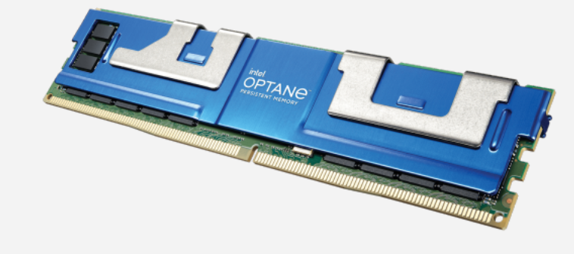
Persistent Fragmentation
Persistent Memory Object Pool
Page 1
Page 2
Page 3
Page 4
Persistent fragmentation gets worsen with subsequent usages
Intel Persistent Memory
Persistent Fragmentation
Higher Density
Byte-addressable Persistence
DRAM-like Performance
First process
Second process
Third process
Live object
Notes:
object life time > process life time

Slide 54
Performance Degradation from Persistent Fragmentation
Redis throughput for 2M insertions and 1M deletions
25% Reduction
Notes:
美化图片

Slide 55
Garbage Collection (GC)
Garbage Collection Steps
Persistent Memory Object Pool
1) Marking
GC metadata (forwarding table, etc.)
2) Summary
Page 1
Page 2
How to design efficient crash-consistent GC?
3) Compaction
2
1
2
2: Not moved
2: Moved
Relocation
3: Not moved
Update metadata
Inconsistent State!
Crash!
Update Reference
Live object
Pointer

Slide 56
Concurrent Garbage Collection
Step 3: Compaction
Step 1: Marking
Step 2: Summary & Sweep
Relocation
Update reference
CG Metadata
(e.g., compacting pages, forwarding table)
No Crash-consistent Requirement
Requires Crash-consistent Designs

Slide 57
Concurrent Compaction: Read Barrier
p->first = input //p points to object A
<read barrier>
1) Check A is in compacting page
2) Lookup new address
3) Check A is not moved
4) Memcpy A to the new address
5) Update moved[A]=1
6) Update reference p to the new address
GC Metadata
(e.g., compacting pages, forwarding table)

Slide 58
Crash-consistent Concurrent Compaction Baseline[1]
p->first = input //p points to object A
<read barrier>
Persist GC metadata before compaction
(e.g., compacting pages, forwarding table)
1) Check A is in compacting page
2) Lookup new address
3) Check A is not moved
4) Memcpy A to the new address
5) Update moved[A]=1
6) Update reference p to the new address
sfence()
clwb(moved[A]);sfence()
Crash-consistency relocation incurs about 50% overhead!
[1] Mingyu Wu, et al. Espresso: brewing java for more non-volatility with non- volatile memory. ASPLOS 2018

Slide 59
Can we remove the first sfence?
1 memcpy_nodrain(y,x,sizeof(A))
2 sfence();
3 moved[A]=1;
4 clwb(moved[A]);sfence();
5 o=y;
Post-crash inconsistent states
Observations
Single-fence solution
Recovery: compare values with memcpy source for objects without reference update
Differ: Redo memcpy and update moved
Same: Update moved
GC metadata
Compaction Page
Destination Page
1) memcpy source data is clean
Partially moved:
2) References are not updated
moved[A]=1
3) memcpy destination value is original or memcpy source
Live object
Cacheline
Notes:
GC record this information

Slide 60

Can we remove the second sfence?
1 memcpy_nodrain(y,x,sizeof(A))
2 moved[A]=1;
3 clwb(objA); sfence();
4 o=y;
Observations
Numerous possible post-crash inconsistent states
1) memcpy source data is clean
2) References may be updated
3) Memcpy destination value is original, memcpy source,
or the new value overwritten by application
If we can distinguish the original value from the new value
New value or memcpy source: Redo other cachelines of this object
Original value: Undo side effects

Slide 61
Crash-consistent Concurrent Compaction Baseline
p->first = input //p points to object A
<read barrier>
1) Check A is in compacting page
2) Lookup new address
3) Check A is not moved
4) Memcpy A to the new address
5) Update moved[A]=1
6) Update reference p to the new address
More details in the paper
sfence()
Fence-free design
clwb(moved[A]);sfence()

Slide 62
Design Summary

Slide 63
Design Summary

Slide 64
Design Summary

Slide 65
Agenda
Memory Exposure Reduction
Process level (ASPLOS 2020)
Intra-process level (ISCA 2020)
Programming support (HPCA 2022)
Persistent Memory Defragmentation (ISCA 2022)
SoftPM: Software Persistent Memory (In submission)
SoC Contention Modeling (MICRO 2021)

Slide 66

SoftPM: Software Persistent Memory
Yuanchao Xu, Wei Xu, Kimberly Keeton, David E. Culler

Slide 67
Another Way to Embrace Directly Addressable Persistence
NV-DRAM (Software Pmem):
Conventional DRAM (DDR4) with rack-scale battery backup
Data Center
NV-DRAM
Power
Can NV-DRAM accelerate the adoption of HardPM?
Can NV-DRAM perform better than HardPM?
Intel Optane DC Persistent memory
(Hardware Pmem)
Battery rack
HardPM hasn’t become ubiquitous in data centers
NV-DRAM has:
Lower performance than DRAM
System software and application redesigns
System software and application optimizations
Directly addressable persistence
DRAM performance
Limited capacity *
Notes:
By NV-DRAM we mean conventional large DRAM (DDR4, etc) with typically rack-scale battery backup …
* Explain on next slide

Slide 68
NV-DRAM Limitation: Bounded Save Window
DRAM
Persistent Region
NV-DRAM
Power
Battery
Save Window Size ~= Flush_time * Storage_BW
~60s data flush @ ~1GB/s
Storage
Notes:
Can’t flush everything in the persistent region.

Slide 69
Applications are Architected with Persistence Models
Application
Data region
Log region
Necessary for
persistence
Old version
Replay
Flush
Storage
Old version of data region
Logs
Notes:
Applications have utilized persistence for decades.
Typically transactional semantics require a log of some, in addition to the primary data object
Normal operations are performed both on the objects and the logs.
Log is periodically flushed to storage
Under failure, the in-memory object is restored from the old version, potentially, a snapshot.
The logs are replayed to restore it to a newer version

Slide 70
Software Persistent Memory Methodology
Applications
Dominate Persistence Models
SoftPM system
Interfaces
NV-DRAM
Storage
Notes:
%In general, HardPM presupposes a particular persistence model (what we call “large in-memory persistence”)
%SoftPM is flexible, as it is built from conventional, general purpose hardware
So the methodology of investigating it is important.
It has two aspects:
Identify the dominant persistence models used in applications
Structure the systems infrastructure accordingly
We walk through that in this talk
We focus on the performance under normal operation, restoration on failure is essentially the same as in conventional scenarios (such as persist to SSD or remote device)

Slide 71
Agenda
Motivation
Application persistence models
SoftPM design and implementation
Multiple versions of Redis
Evaluation

Slide 72
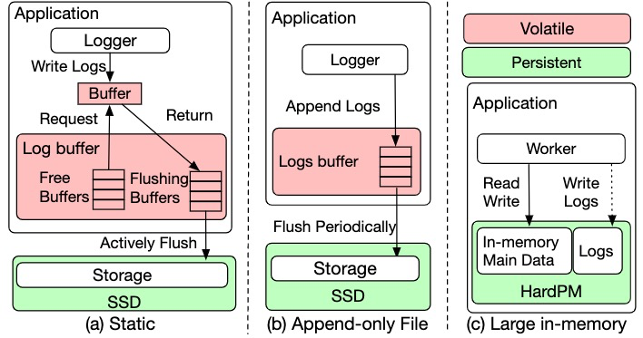
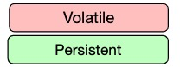
Persistence Models
Static:
Applications fully manage the fixed-size region
Append-only:
Applications consistently append logs to the in-memory region
Large in-memory persistence:
Data flushed from cache to memory is persistent
(a) Static
(b) Append-only
(c) Large in-memory
Notes:
Structure the systems infrastructure accordingly

Slide 73
SoftPM Static
Design
Tag all allocated regions as save window region

Slide 74
SoftPM User-directed
Characteristics of append-only persistence model
Appended logs are not overwritten again
Design
Background flushing
Users can deliver read-only hints to the SoftPM system
Save window size control

Slide 75
SoftPM Transparent
Design
Dirtiness-aware save window size control
User-transparent background flushing

Slide 76
SoftPM Transparent Implementation
Write
Custom page fault handler
Trap
Dirty_pages = save_window?
SoftPM pages are
write-protected
Yes
Wait for finishing one page flush
No
1) Unset write-protected bit
2) Add this dirty page
Dirty page manager
Periodically
Scan, clean and record all dirty pages’ reference bit
Dirty pages> threashold
Trigger
1) Flush LRU pages until dirty pages is smaller than the threshold
2) Set write-protected bit for flushed pages

Slide 77
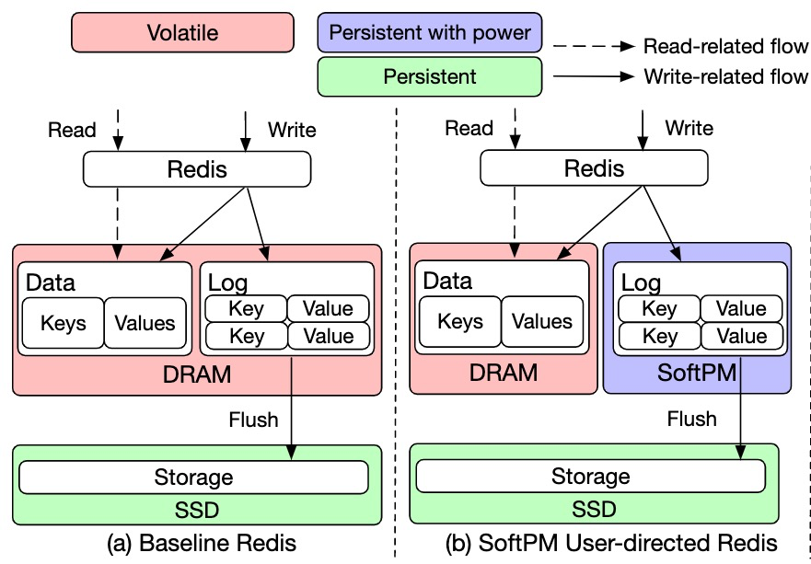
Multiple Versions of Redis
(a) Baseline
(b) SoftPM User-directed

Slide 78
Multiple Versions of Redis
(a) Baseline
(b) SoftPM User-directed

Slide 79
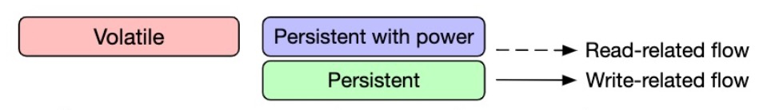
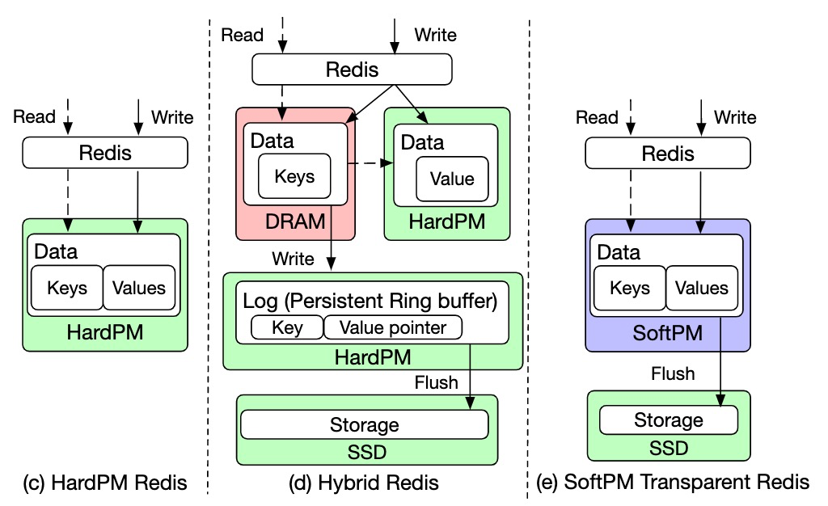
Multiple Versions of Redis
(c) HardPM
(d) Hybrid
(e) SoftPM Transparent

Slide 80
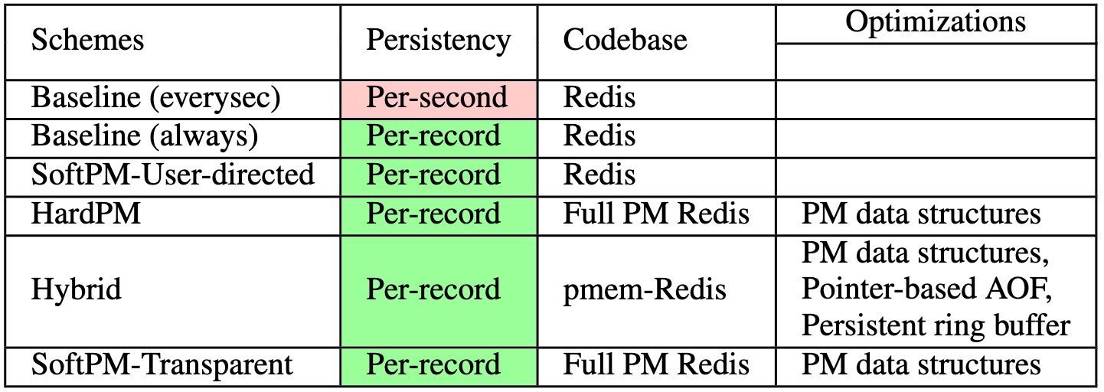
Summary of Multiple Versions of Redis

Slide 81
Evaluation
Experiment setup
28-core Intel Xeon Platinum 8273CL@2.20GHz
6-channel HardPM, 6-channel DRAM and a SSD
All server and client threads are running on different cores in one socket
Unlimited save window size
Microbenchmark
YCSB
Limited save window size (30 GB SoftPM data, 3G (10%)-30G(100%) save window)
YCSB

Slide 82
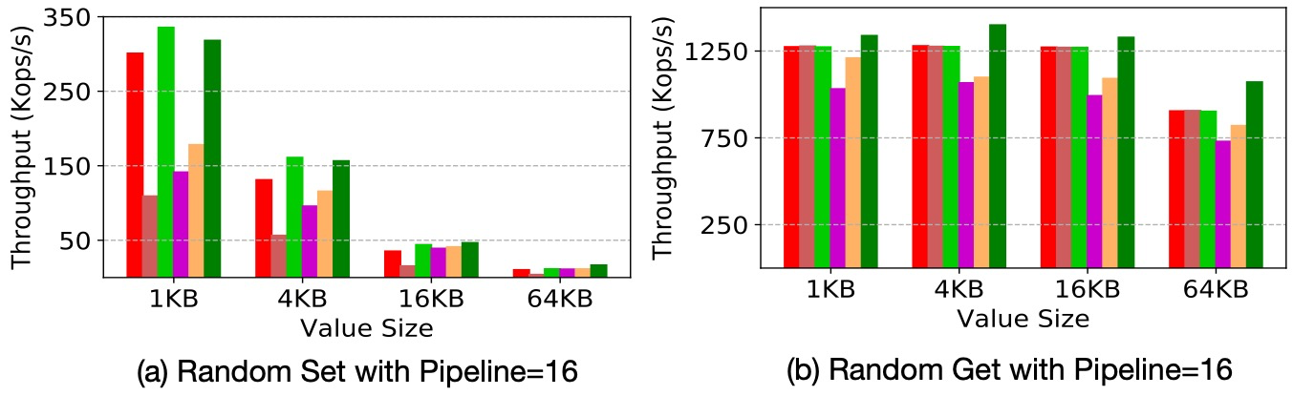
Microbenchmark Evaluation
SoftPM Transparent Improves 7%-88% throughput over the Hybrid

Slide 83
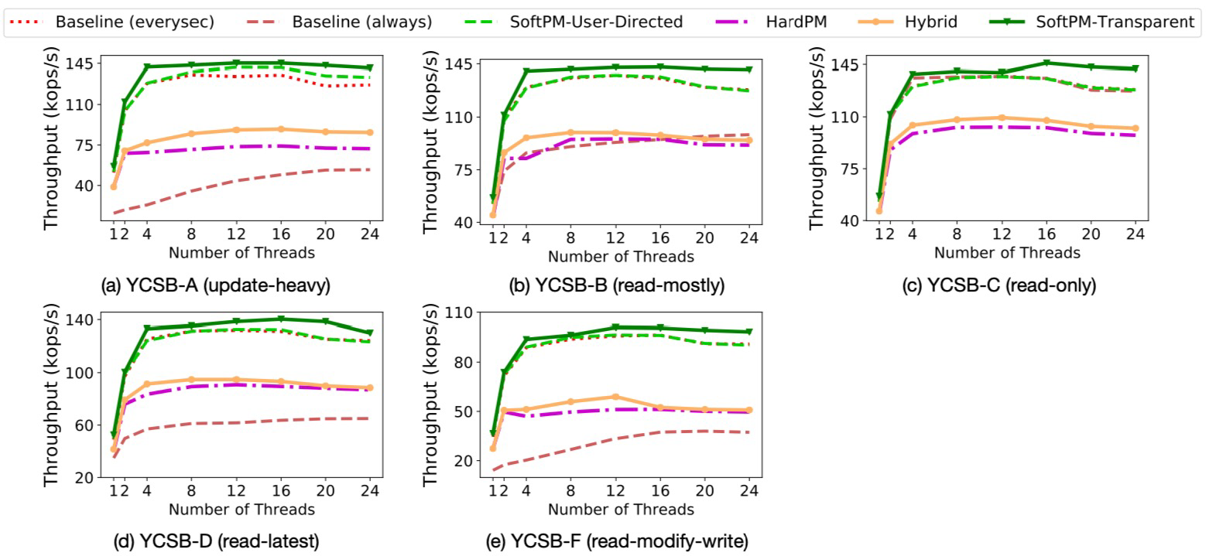
YCSB Evaluation
SoftPM Transparent Improves 38%-93% throughput over the Hybrid

Slide 84
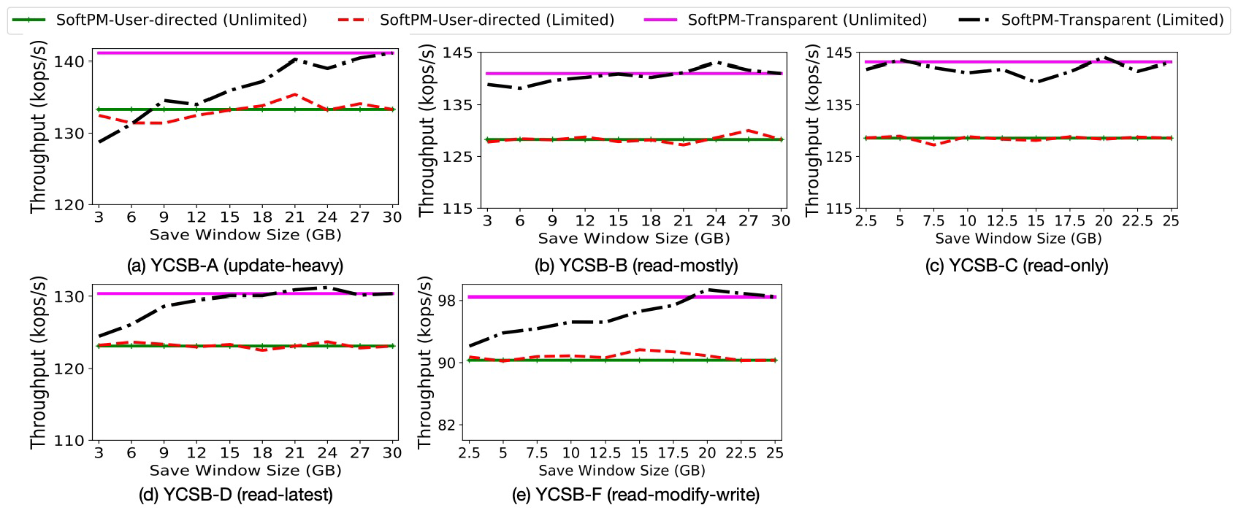
YCSB Evaluation with Limited Save window
SoftPM incurs at most 9% overhead with 10% save window size

Slide 85
Conclusion
SoftPM is potentially available using technology already provisioned in data centers today
SoftPM improves 38%-93% throughput over the well-optimized Hybrid (DRAM and HardPM) versions.
Real DRAM performance memory
Background flushing
Cleaner designs
SoftPM also sets the performance bar that future HardPM and its ecosystem will need to beat.

Slide 86
Agenda
Memory Exposure Reduction
Process level (ASPLOS 2020)
Intra-process level (ISCA 2020)
Programming support (HPCA 2022)
Persistent Memory Defragmentation (ISCA 2022)
SoftPM: Software Persistent Memory (In submission)
SoC Contention Modeling (MICRO 2021)

Slide 87


PCCS: Processor-Centric Contention Slowdown Model for Heterogeneous System-on-Chips
Yuanchao Xu, Mehmet E. Belviranli, Xipeng Shen, Jeffrey Vetter
MICRO 2021

Slide 88




Heterogenous System-on-Chips (SoCs)
Smartphones
Autonomous Vehicles
Robots
Drones

Slide 89
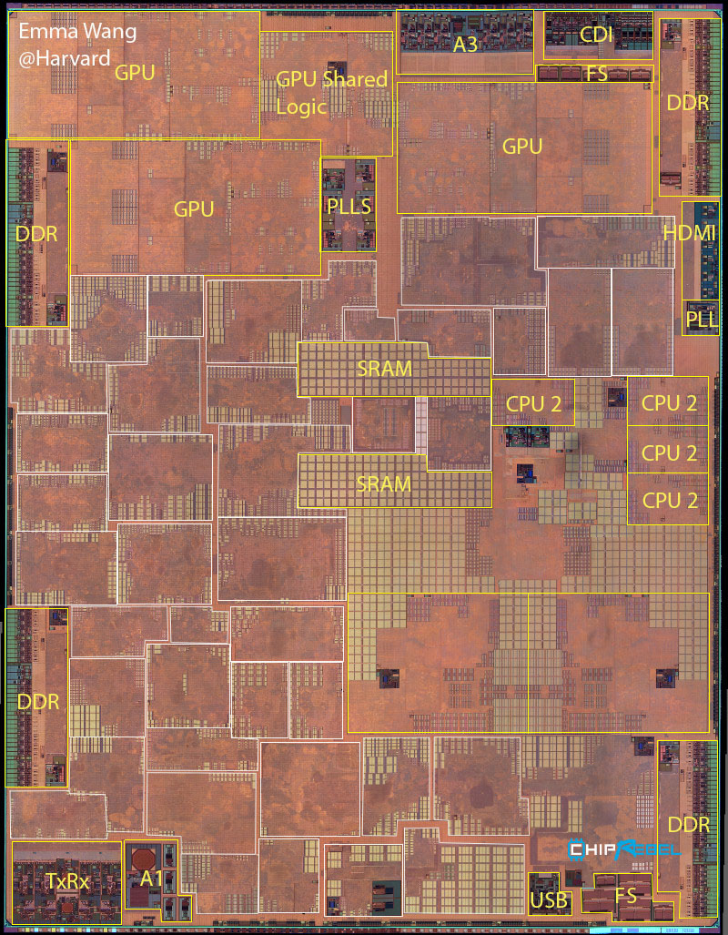
Diversely Heterogeneous Architectures
More than 40 intellectual property (IP) blocks in A11!
Apple A11 die photo
Source: http://vlsiarch.eecs.harvard.edu/research/accelerators/die-photo-analysis/

Slide 90
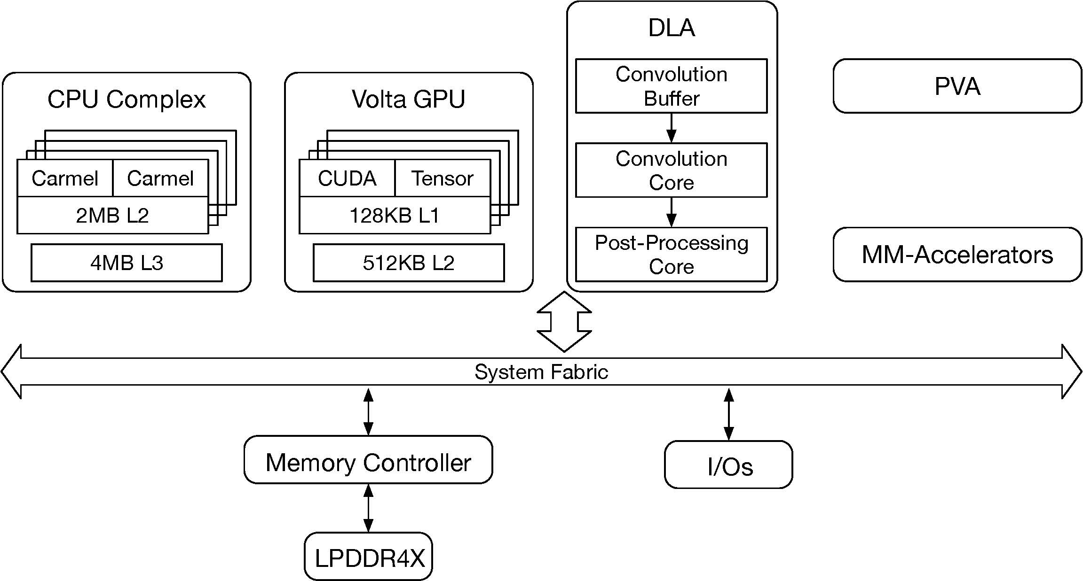
Heterogenous SoC Example
5-processor unit (PU) NVIDIA Jetson Xavier
Task 6
Task 5
Task 3
Task 2
Application
Task 4
Task 1

Slide 91
Heterogenous SoC Example
5-processor unit (PU) NVIDIA Jetson Xavier
Application
Task 1
Task 2
Task 3
Task 5
Task 4
Task 6

Slide 92
Commercial SoCs are Challenge To Design
Which PUs to use?
# of Cores of PUs?
Frequencies of PUs?
Total bandwidth?
Performance Requirements
Budget
Constraints
Set of PUs
Target
Applications
Analysis Memory Contention
Capture Contention effects
Predict co-located slowdown
Our work
Numerous possible designs
Memory Contention
Several efficient designs

Slide 93
Contributions
Built the fundamental understanding of memory contention on SoCs
Designed processor-centric contention-aware slowdown model
Predicted accurate memory contention effects, improving
70% prediction accuracy over the state-of-the-art work
Identified the real bottleneck of SoCs at pre-silicon stage, saving up to 50% frequency or number of cores

Slide 94
Outline
Background
Observation
Architectural analysis
PCCS model
SoC design guidance

Slide 95
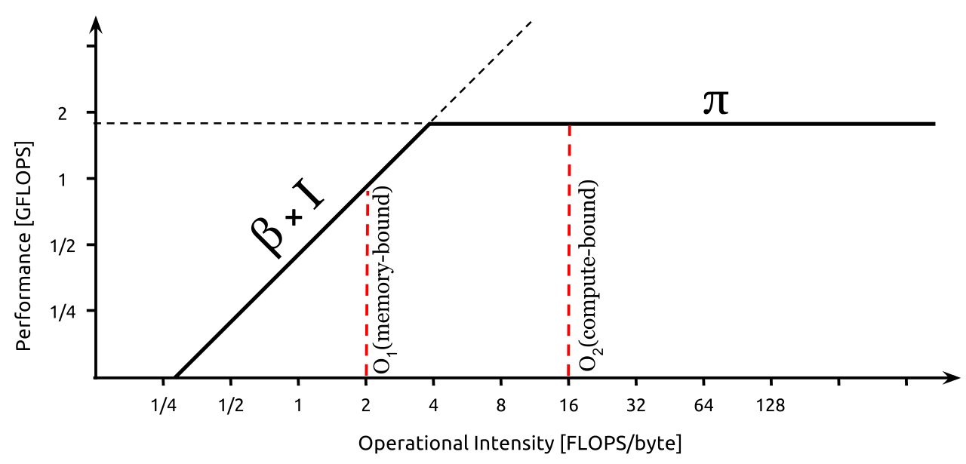
Computer Architecture & Performance Models
Performance model vs. Simulation
More insights
Less efforts and time
Don’t need architectural details
Roofline Model
Gables
Our work
Performance Models
Next generation SoCs
SoCs
Better utilization
Pre-silicon
Post-silicon
Source: https://commons.wikimedia.org/wiki/File:Example_of_a_naive_Roofline_model.svg

Slide 96
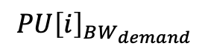
State-of-the-art Contention Model: Gables ^{[1]}
PU 1
PU 2
PU 3
Roofline Model
$$PU{\left[i\right]}_{BW_{demand}}$$
Memory Bandwidth Contention Model
Total BW demand < Peak BW
Total BW demand > Peak BW
$$PU{{\left[i\right]}_{obtained}}_{BW}=PU\left[i\right]_BW_demand$$
$$PU{{\left[i\right]}_{obtained}}_{BW}=PU{\left[i\right]}_{BW_{demand}}∗\frac{Peak_BW}{Total_BW_demand}$$
[1] Mark D. Hill, et al., Gables: A Roofline Model for Mobile SoCs, HPCA 2019

Slide 97
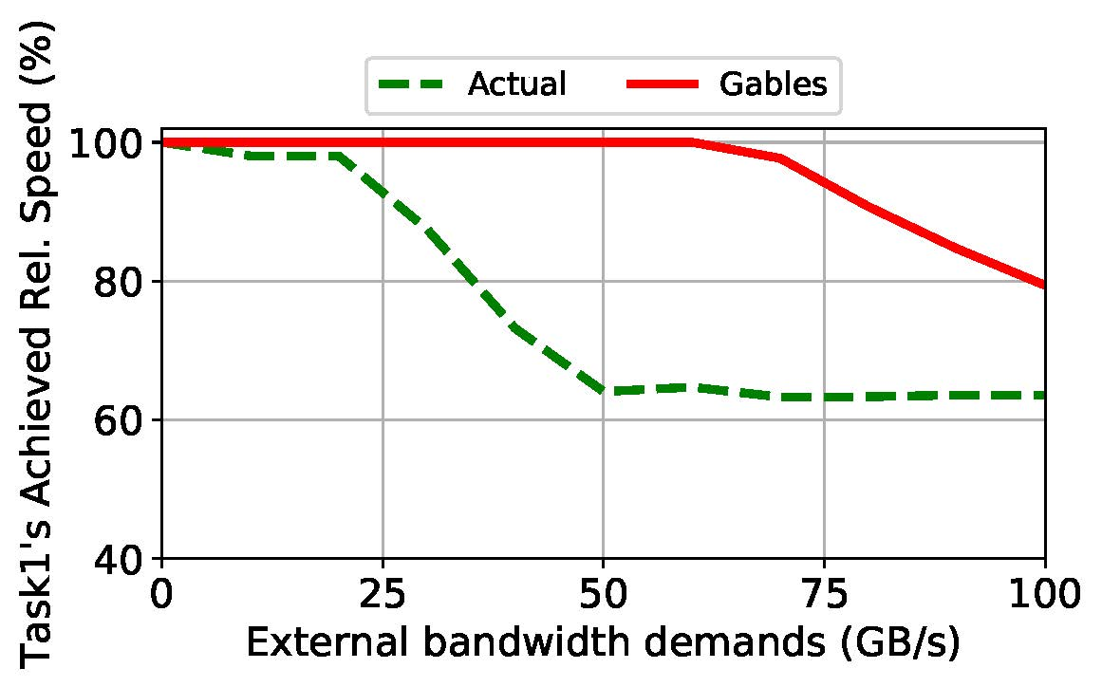
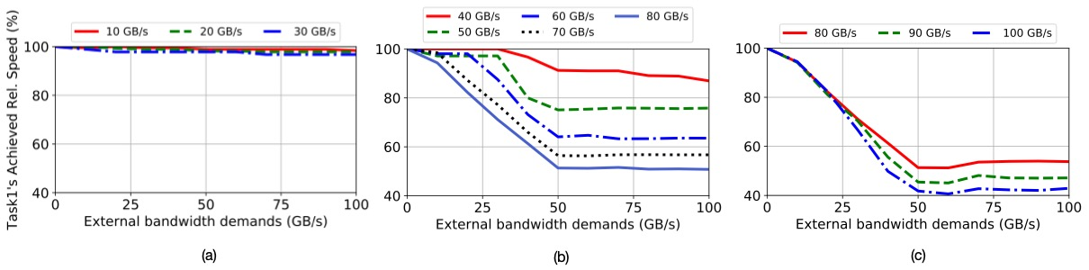
Something Gables Missing
Task 1
Vary the total external bandwidth demand from other tasks
Task 2
Task 3
Observe task 1’s performance:
PU 1 (GPU)
PU 2 (CPU)
PU 3 (DLA)
Vary the task 1 BW demand

Slide 98
Observations
Task 1
Vary the total external bandwidth demand from other tasks
Task 2
Task 3
Observe task 1’s performance:
PU 1 (GPU)
PU 2 (CPU)
PU 3 (DLA)
Vary the task 1 BW demand
Task 1 BW demand ≤ 30 GB/s
40 GB/s ≤ Task 1 BW demand ≤ 80 GB/s
Task 1 BW demand ≥ 80 GB/s

Slide 99
Outline
Background
Observation
Architectural analysis
PCCS model
SoC design guidance

Slide 100
Architectural analysis
Hypothesis: Caused by fairness control in memory system

Slide 101
Purpose of Fairness Control
Stream Access
Program
Random Access
Program
IP 1
IP 2
Memory 1
Memory 2
Thomas Moscibroda, et al., Memory Performance Attacks: Denial of memory service in multi-core systems, USENIX Security 2007

Slide 102
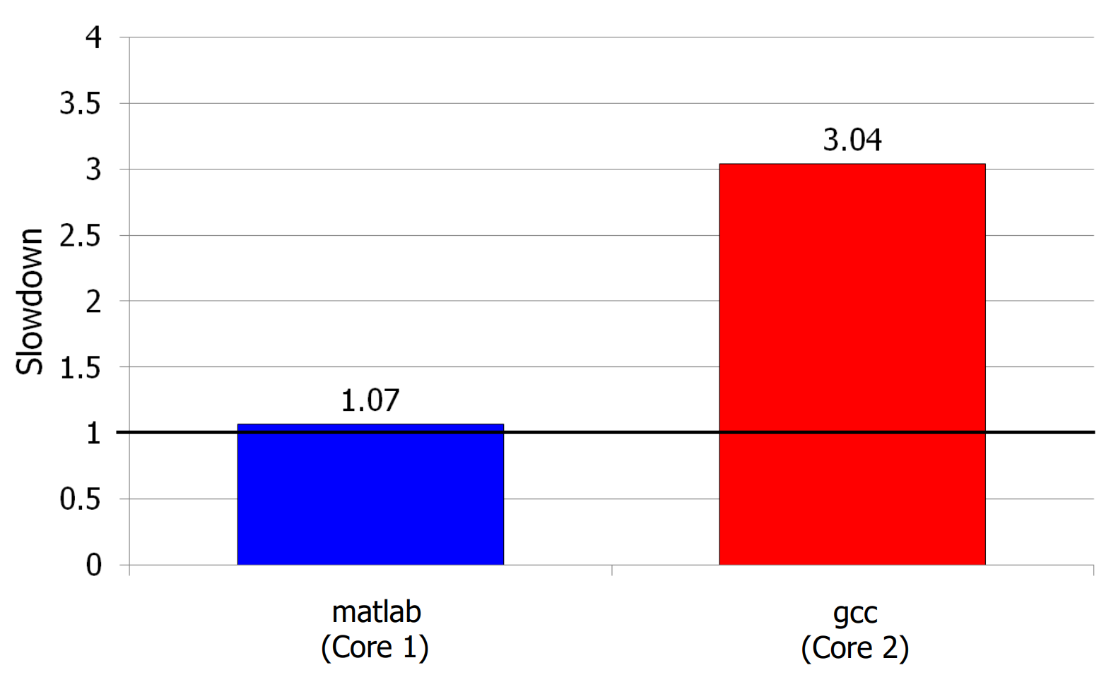
Purpose of Fairness Control
Similar
Co-located
Performance
Stream Access
Program
Random Access
Program
Significant
slowdown
IP 1
IP 2
Shared Memory
Fairness control is important in memory controller
Reduce denial of memory service vulnerabilities
Improve overall throughput
Improve quality-of-service
Thomas Moscibroda, et al., Memory Performance Attacks: Denial of memory service in multi-core systems, USENIX Security 2007

Slide 103
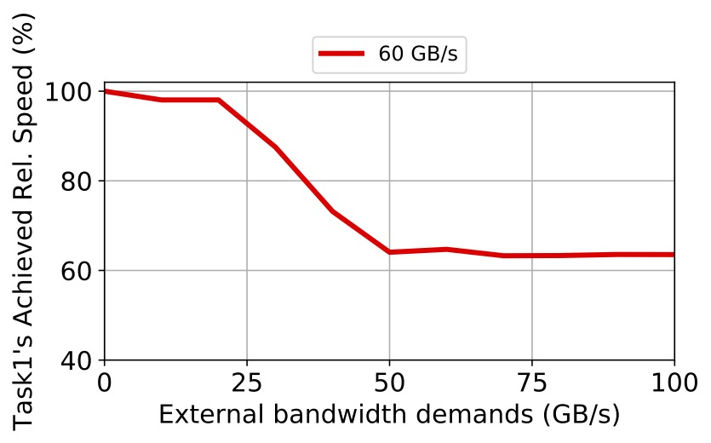
Bandwidth Partitions with Fairness Control
ATLAS[1]: Similar attained service time
Peak BW 80GB/s
Stage 1
Stage 3
Stage 2
Stage 1
Stage 2
Stage 3
Task1: 60GB/s
Task2: 20GB/s
Task1: 60GB/s
Task2: 30GB/s
Task1: 60GB/s
Task2: 80GB/s
BW demands:
Obtained BW:
Task1: 60GB/s
Task2: 20GB/s
Task1: 50GB/s (83% of 60GB/s)
Task2: 30GB/s
Task1: 40GB/s (67% of 60GB/s)
Others: 40GB/s
[1] Yoongu Kim, et al., ATLAS: A Scalable and High-Performance Scheduling Algorithm for Multiple Memory Controllers, HPCA 2010

Slide 104
Memory Controller Policy Simulation
Methodology:
1
Implement memory controller policies in Ramulator[1]
Task 1
Vary the total external bandwidth demand for other tasks
Task 2
Task n
2
Observe task 1’s
performance:
IP 1
IP 2
IP n
3
Vary task 1 bandwidth demands; Repeat Step 2
[1] https://github.com/CMU-SAFARI/ramulator

Slide 105
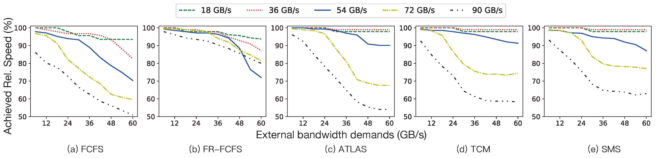
Memory Controller Policy Simulation
Close to Gables model
Close to the observations
Name | Policies
FCFS | First-come-first-server.
FR-FCFS | First ready; First-come-first-server.
ATLAS | Higher the ranks of threads with least attained service.
TCM | Higher non-memory-intensive programs
SMS | Shortest first round robin

Slide 106
Outline
Background
Observation
Architectural analysis
PCCS model
SoC design guidance

Slide 107
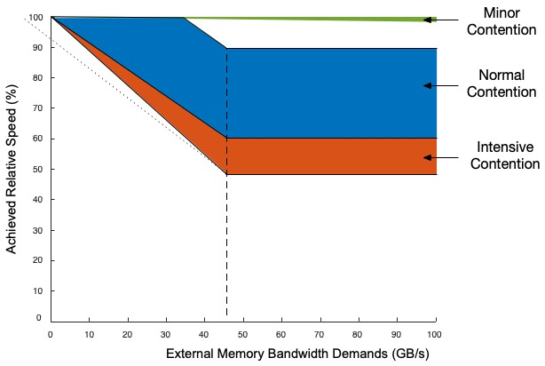
Processor-Centric Contention-aware Slowdown Model (PCCS)
Three-region interference-conscious Model
Piecewise slowdown functions in each region
Target PU’s Task BW demand
Achieved relative
speed under memory contention(%)
External BW demand

Slide 108
PCCS parameters
TBWDC
MRMC
Maximum Reduction of Minor Contention (MRMC)
Total Bandwidth Demand with Contention (TBWDC)
Contention Balance Point (CBP)
Reduction Rate
Reduction Rate
CBP
More detail in the paper

Slide 109
Outline
Background
Observation
Architectural analysis
PCCS model
SoC design guidance

Slide 110
PCCS Model Usage
Memory Variations
(frequencies, # of channels, bit width)
Task Placement Scheme
Linear Scaling
BW
demands
Task 1
Task n
Standalone Performance
PCCS
Co-located
Slowdown
IP 1
IP n
PU Variations
(#of cores, frequencies, features)

Slide 111
Case study
Program: streamcluster in Rodinia Benchmark Suite
Objectives: Find appropriate frequencies of the GPU within 5% and 20% co-located slowdown on Xavier when external BW demands are 20GB/s, 40GB/s and 60GB/s
Methodology: PCCS model usage
Validation: Change the power settings of Xavier to obtain the ground truth
Baseline: Gables model

Slide 112
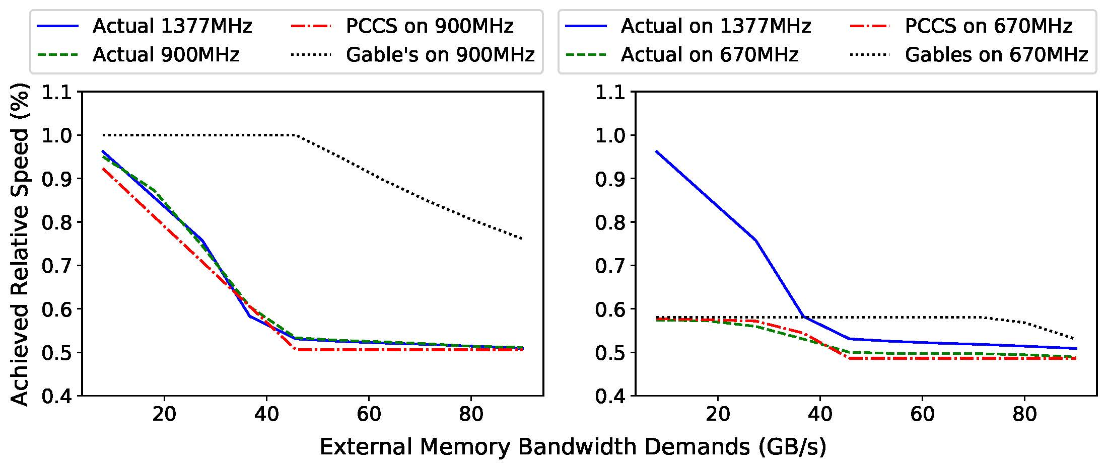
Results on streamcluster benchmark
Objective: within 5% slowdown
Objective: within 20% slowdown
External BW demand (GB/s) |  | 20 | 40 | 60 | Average | 20 | 40 | 60 | Average
 |  | Errors
 |  | PCCS |  |  |  | Gables
Maximum Allowed Slowdown | 5% | 2.4 | 3.1 | 1.6 | 2.4 | 4.8 | 35.4 | 41.9 | 27.4
 | 20% | 1.3 | 1.7 | 3.6 | 2.2 | 3.8 | 36.7 | 49.1 | 29.9

Slide 113
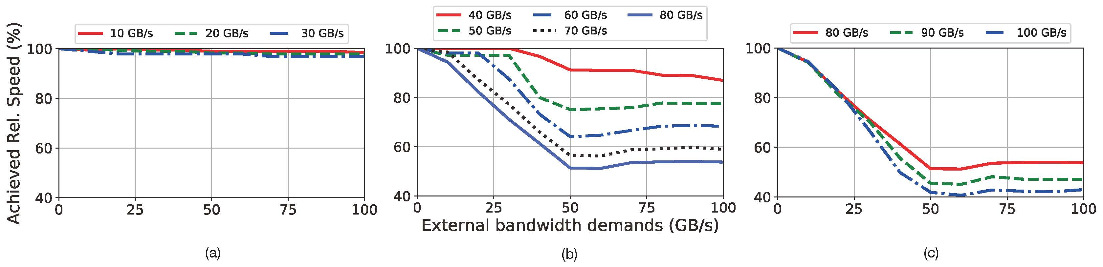
Conclusion
Built the fundamental understanding of memory contention on SoCs
Designed three-region processor-centric contention-aware slowdown model
Thank you for your attentions!
Q & A
Predicted accurate memory contention effects, improving 70% prediction accuracy over the state-of-the-art work
Identified the real bottleneck of SoCs at pre-silicon stage, saving up to 50% frequency or number of cores

